Slide 1

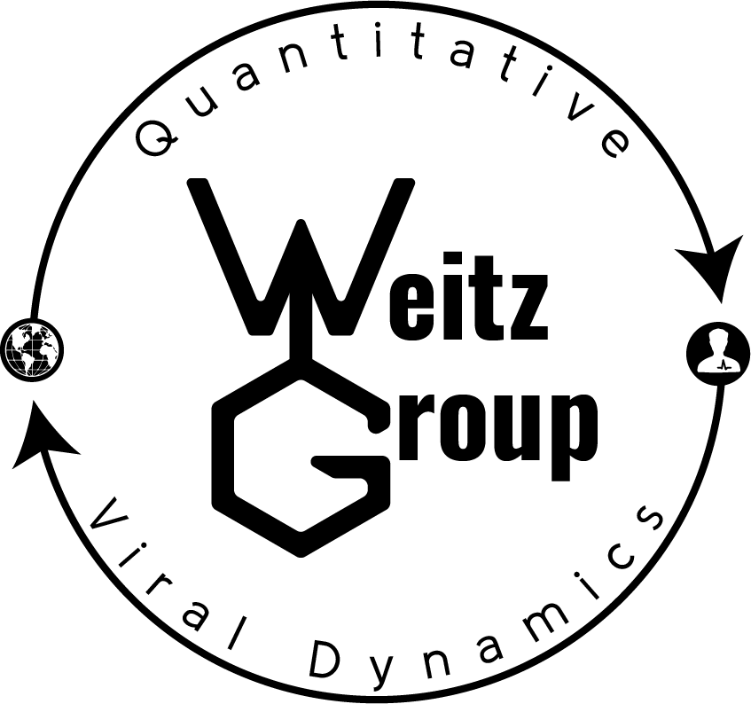


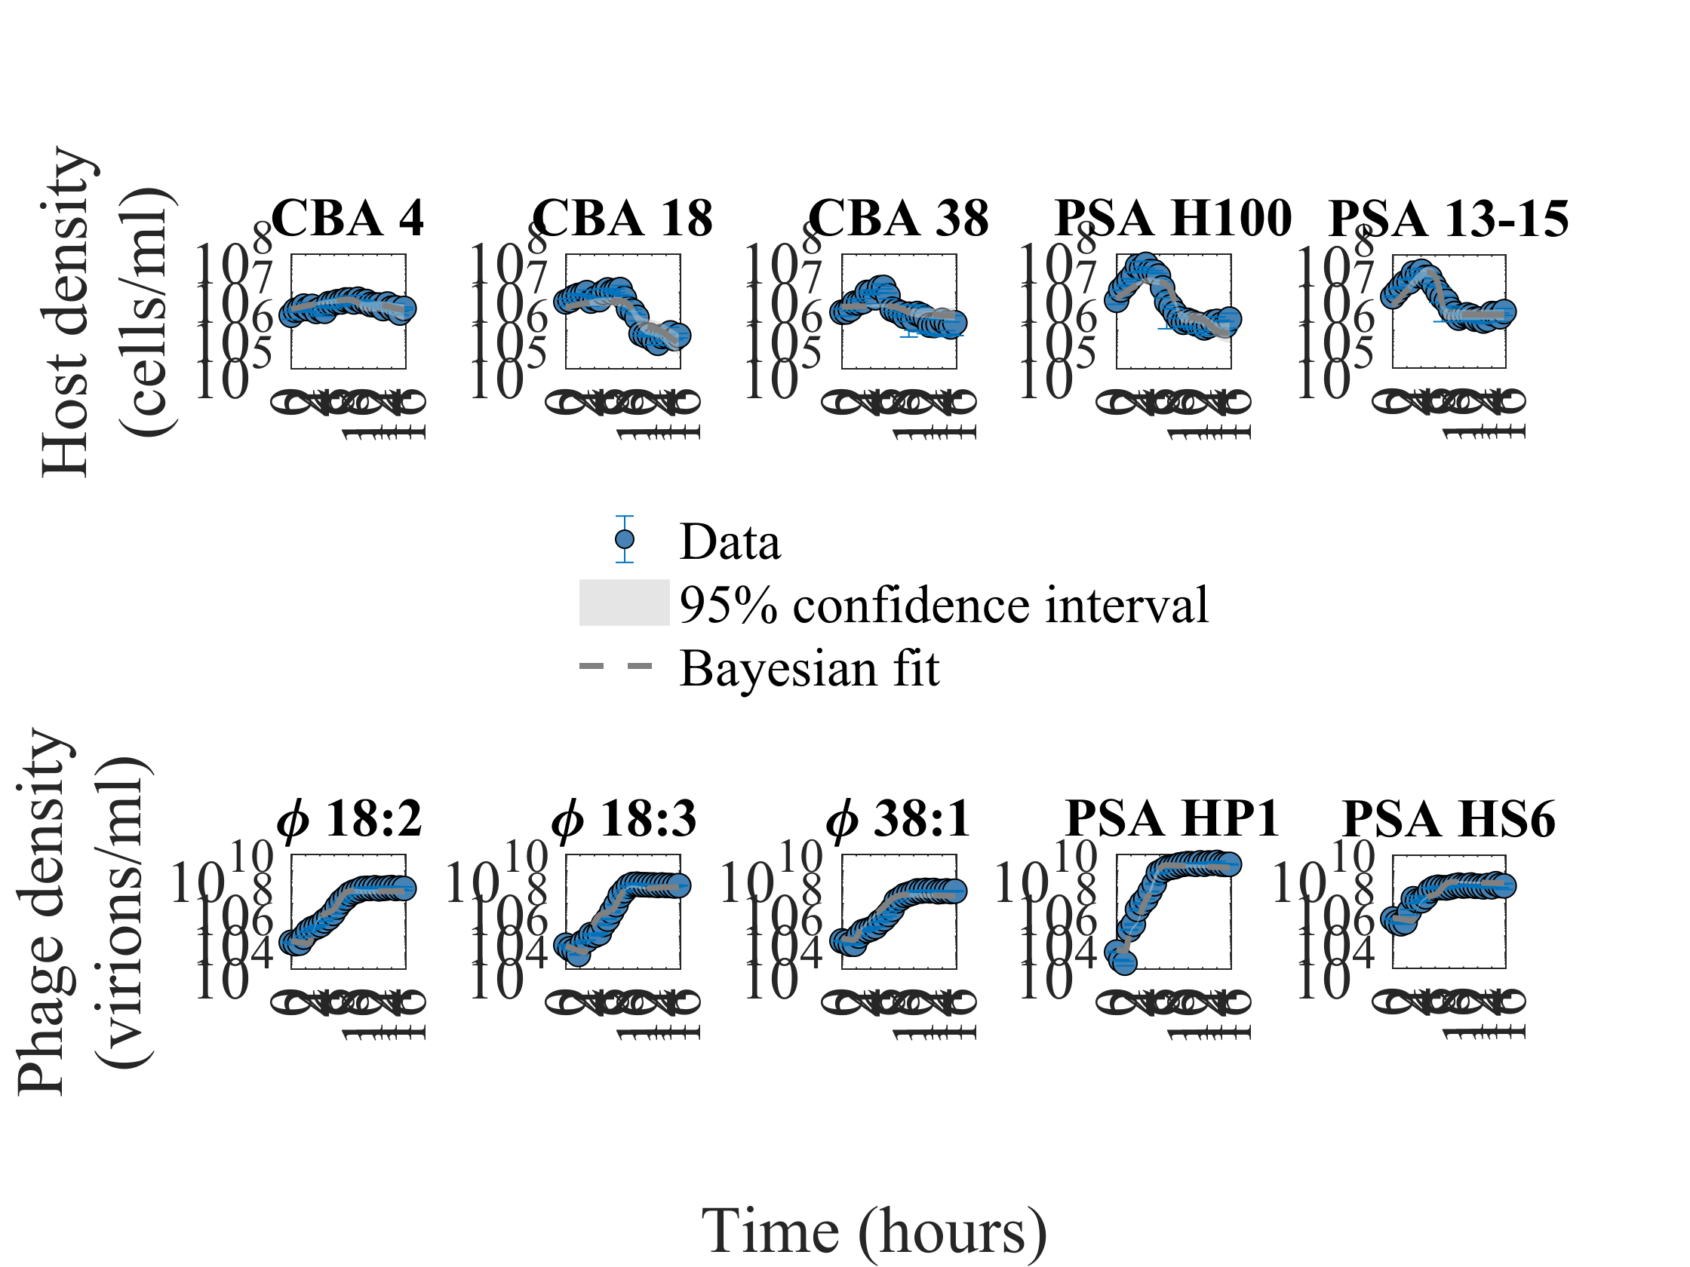
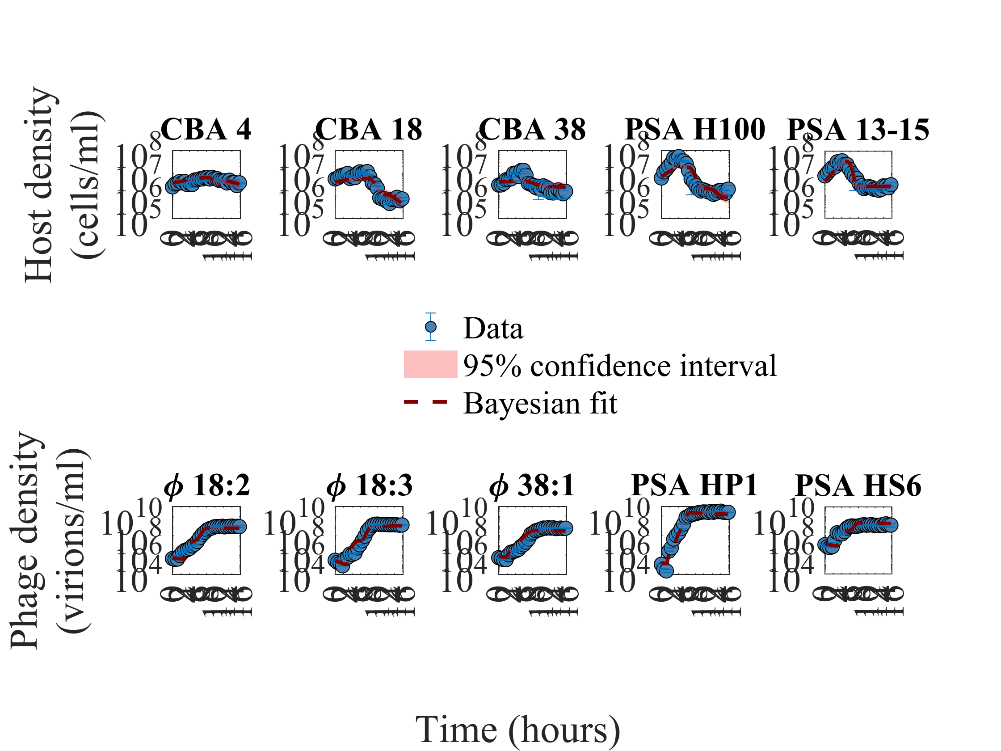
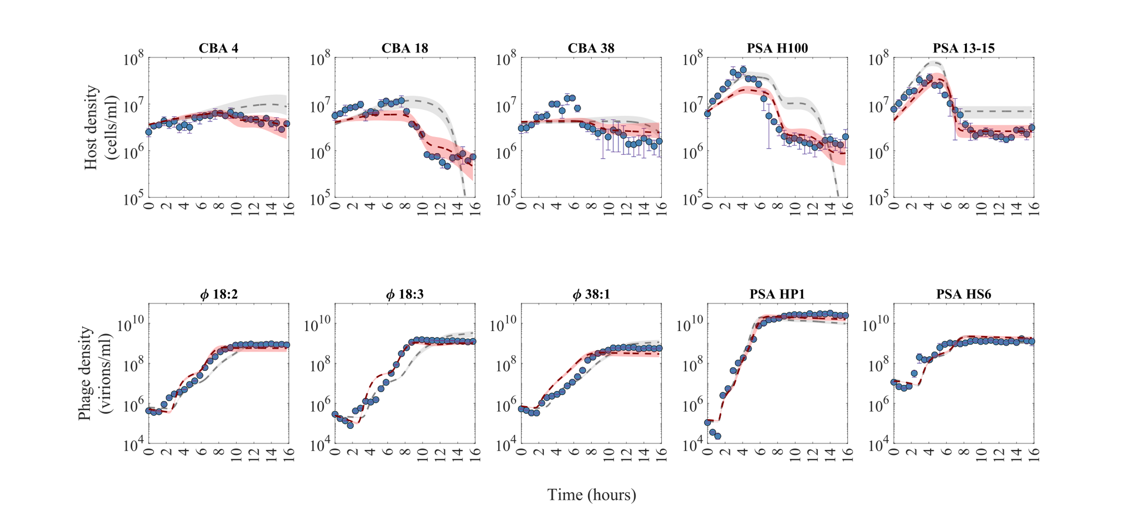
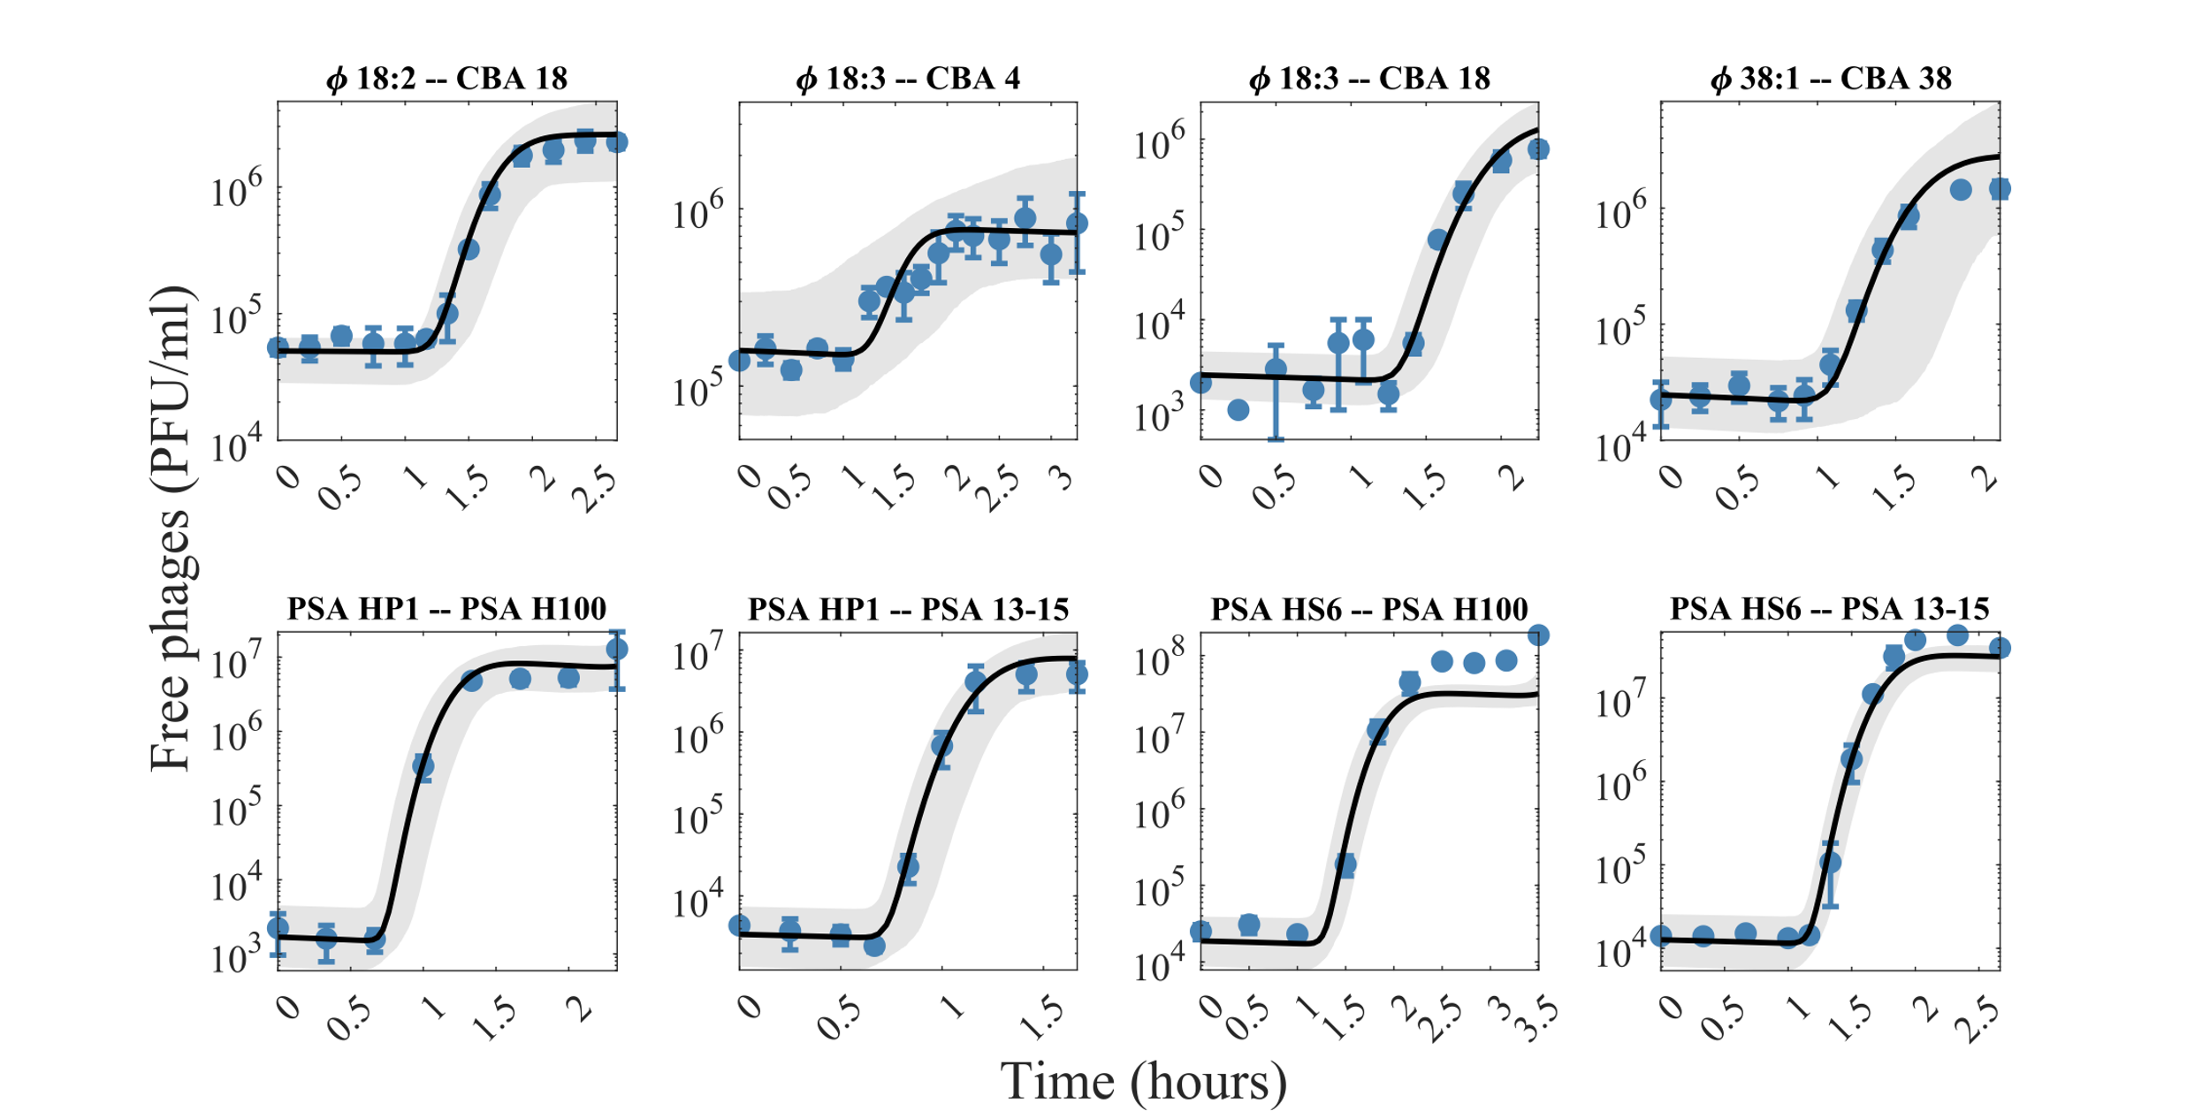
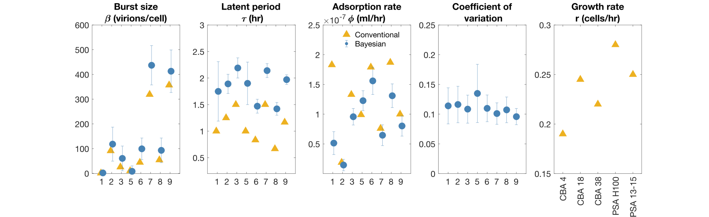
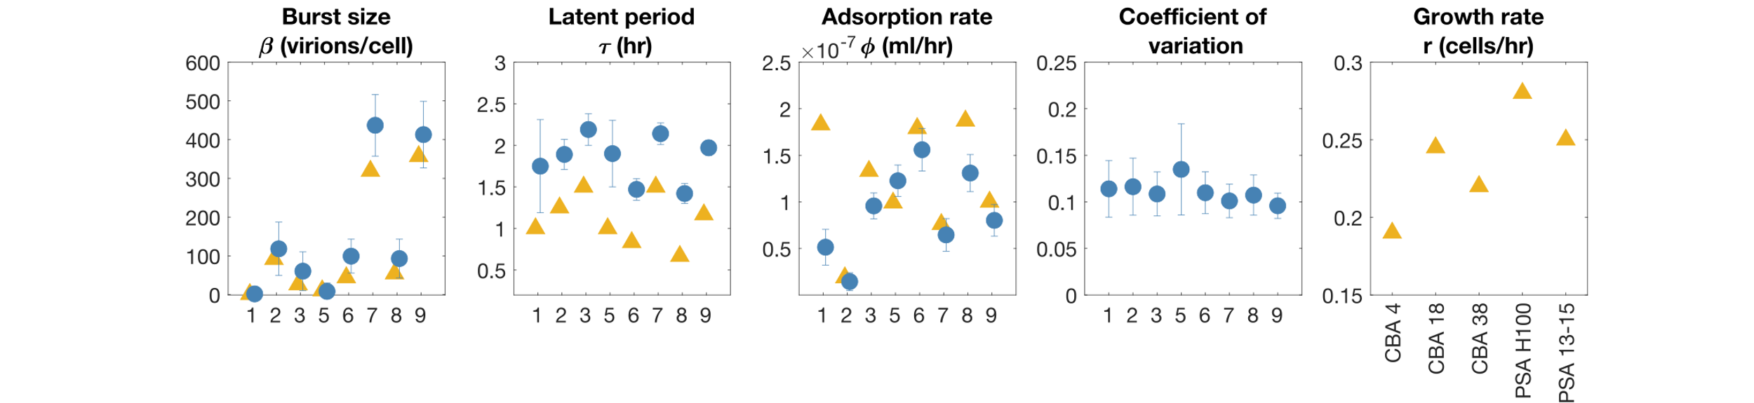
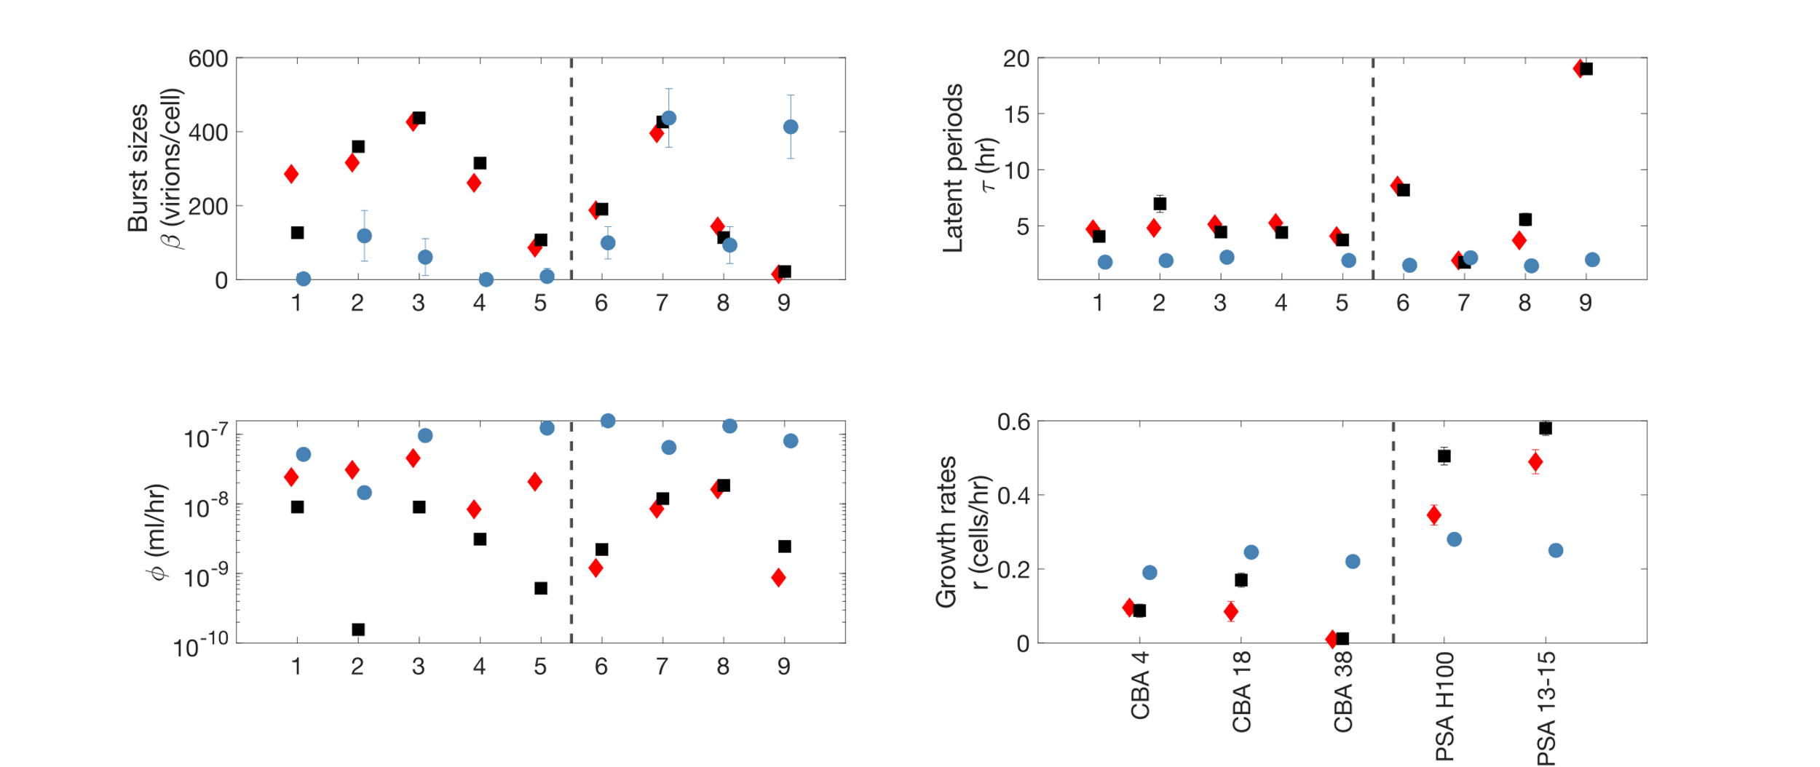
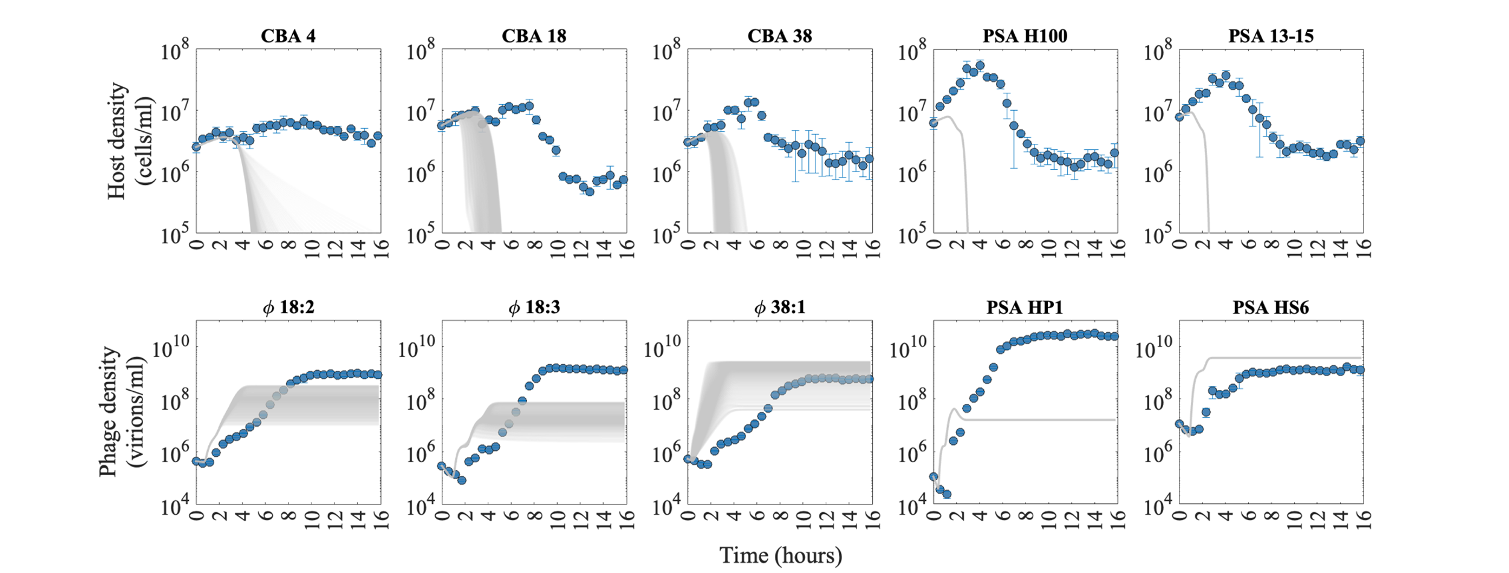
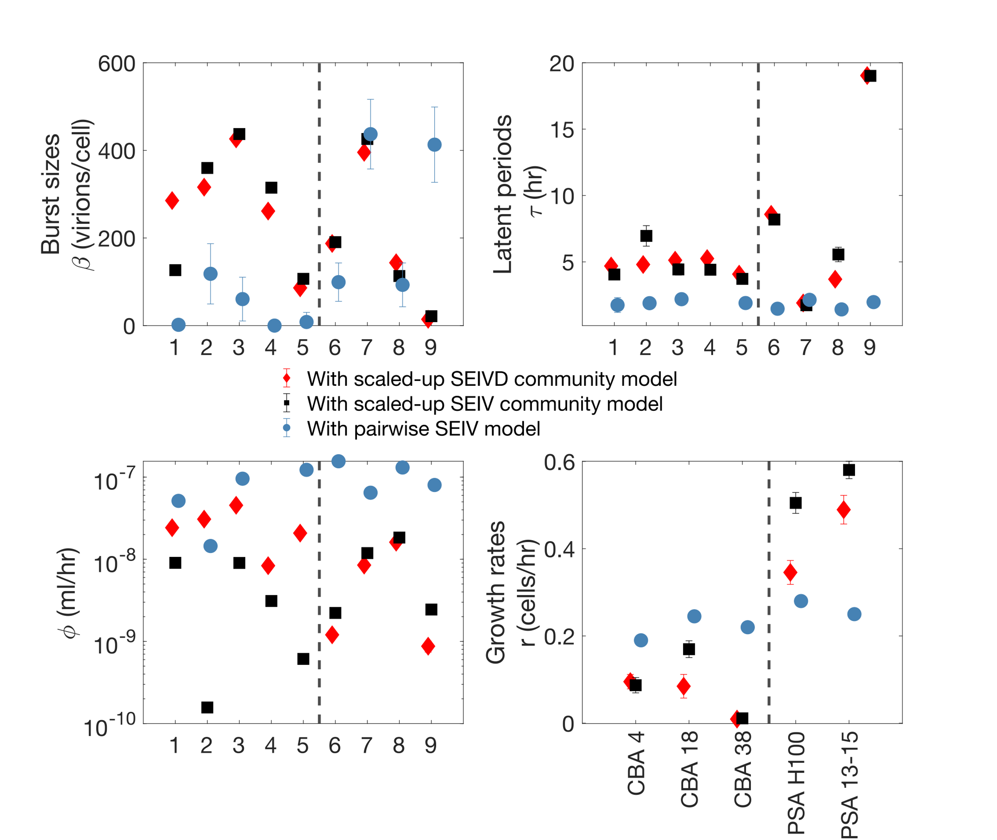


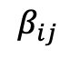
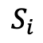
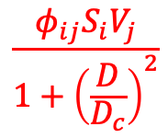
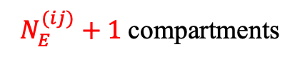

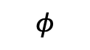
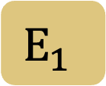
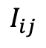
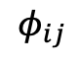
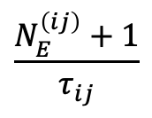
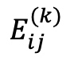
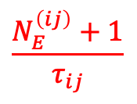
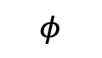
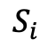
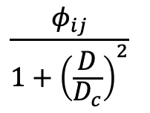
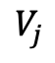
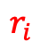
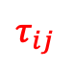

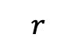
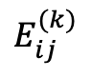
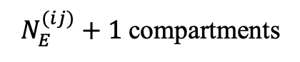
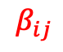
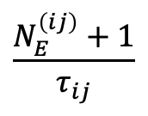
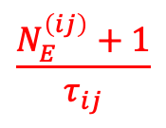
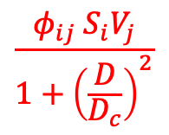
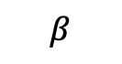
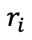
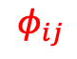
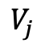
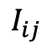

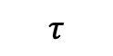
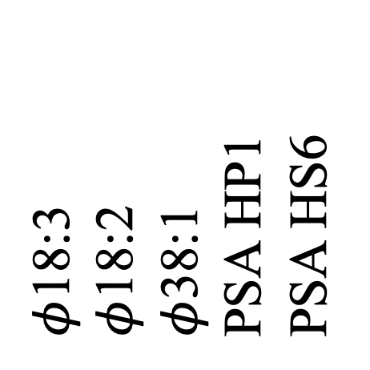
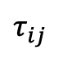
Shift in marine viral life history traits in pairwise versus community settings
Raunak Dey^{1,*}, Ashley Coenen¹, Natalie Solonenko^{2,3}, Christine Sun^{2,3}, Marie Burris^{2,3}, Guillermo Dominguez-Huerta^{2,3}, Anna Mackey^{2,3}, Lauren Chittick^{2,3}, David Demory^{4,5}, Stephen Beckett⁴, Matthew Sullivan^{2,3,6}, and Joshua S. Weitz^{1,4,7}
¹ School of Physics, Georgia Institute of Technology, Atlanta, GA, USA; ² Department of Microbiology, The Ohio State University, OH, USA – 43210; ³ Center for Microbiome Science, The Ohio State University, OH, USA – 43210; ⁴ School of Biological Sciences, Georgia Institute of Technology, GA, USA – 30332;⁵ Sorbonne Universités, UPMC Univ Paris 06, CNRS, Biologie Intégrative des Organismes Marins (BIOM), Observatoire Océanologique, F-66650 Banyuls/Mer, France; ⁶ Department of Civil, Environmental and Geodetic Engineering, The Ohio State University; Columbus, OH, USA – 43210; ⁷ Institut de Biologie, École Normale Supérieure, Paris, France - 75005
^{Scan to connect with me}
*Email: rdey33@gatech.edu
Introduction
IV. Higher order interactions in community: SEIVD model
In complex marine ecosystems, different species of viruses and their hosts coexist together. Understanding their ecological life-history traits, “who infects whom” and scaled up dynamics in community is important for downstream evolutionary, environmental outcomes. [1,2]
We in vitro combined Cellulophaga baltica and Psuedoalteromonas marine bacterial strains with associated phages and recorded the dynamics for all the interacting pairs and for all together in a community.
We build non-linear compartmental models of infection to capture the pairwise dynamics and scale our model by infection matrix to build community dynamics. Additionally, we theorize and incorporate a higher order interaction in our model that inhibits bacterial lysis due to debris.[3] We use Bayesian inference to estimate the life history parameters from experimentally recorded population dynamics for both pairwise and community settings and compare them.
(a)
$$\frac{φ_{ij}S_{i}V_{j}}{1+{\left(\frac{D}{D_{c}}\right)}^{2}}$$
$N_{E}^{(ij)}+1$compartments
$$D$$
$$\frac{φ_{ij} S_{i}V_{j}}{1+{\left(\frac{D}{D_{c}}\right)}^{2}}$$
: 3 state variables term to model inhibition due to cellular debris in the medium
$$\frac{N_{E}^{\left(ij\right)}+1}{τ_{ij}}$$
$$E_{ij}^{(k)}$$
$$\frac{N_{E}^{\left(ij\right)}+1}{τ_{ij}}$$
$$I_{ij}$$
SEIV model
$$r_{i}$$
$$S_{i}$$
…
$$V_{j}$$
SEIVD model
…
Interacting pairs of phage and host
…
Figure 3: Community models for virus-host interactions: (a) To inhibit the lysis phenomenon in the community and mediate coexistence we theorize and add a higher order term due to interaction of accumulating cellular debris (D) in the model (SEIVD); cartoon shown (b) With the scaled up SEIV model and new SEIVD model we estimate community parameters using Bayesian inference. The SEIV model (gray), build only from scaling up interactions can capture community dynamics qualitatively and fails at later times. However, the SEIVD model can capture both community coexistence and temporal dynamics quantitatively.
…
…
…
…
…
$$β_{ij}$$
$φ$18:3
$φ$18:2
$φ$38:1
PSA HP1
PSA HS6
…
$$τ_{ij }$$
II. Pairwise phage-host interactions: Experiments & mechanistic model
(b)
$$φ_{ij}$$
(a)
(b)
S
(c)
$$r$$
$$φ$$
$$E_{1}$$
a
CBA 4
CBA 18
CBA 38
PSA H100
PSA 13-15
2
1
$$⋯$$
3
4
$$τ$$
5
6
7
$$E_{N_{E}}$$
8
9
I
$$φ$$
$$β$$
(d)
V
V. Pairwise vs community life-history traits
CBA
PSA
CBA
PSA
Figure 1. (a) Experimentally obtained infection matrix (b) Rate equation based non-linear SEIV model for pairwise dynamics. (c) One-step growth curve of $φ$18:2 on CBA 18 modeled with SEIV model and shown as an example (d) For 8 out of 9 interactions the life history traits are inferred conventionally from single strain experiments and from Bayesian estimate of SEIV model.
III. Scaled-up SEIV community model
CBA
(a)
$N_{E}^{(ij)}+1$compartments
(b)
CBA
PSA
PSA
$$\frac{φ_{ij}}{1+{\left(\frac{D}{D_{c}}\right)}^{2}}$$
$$\frac{N_{E}^{\left(ij\right)}+1}{τ_{ij}}$$
$$E_{ij}^{(k)}$$
$$\frac{N_{E}^{\left(ij\right)}+1}{τ_{ij}}$$
$$I_{ij}$$
Host density (cells/ml)
$$r_{i}$$
$$S_{i}$$
…
$$V_{j}$$
…
…
Figure 4: Comparison between the Inferred life history traits from data for pairwise vs community settings
…
…
VI. Conclusions and funding source(s)
…
…
Pairwise life history parameters and scaled up model: insufficient to recapitulate dynamics
Higher order interactions may emerge in community to mediate coexistence
Life history parameters shift in community from pairwise settings – comparatively longer latent periods, higher burst sizes and lower adsorption rates seen in community
Gold standard for data-model integration in complex coexisting virus host communities
…
$$β_{ij}$$
…
$$τ_{ij }$$
$$φ_{ij}$$
References
[1] Salmond, G.P. and Fineran, P.C., 2015. A century of the phage: past, present and future. Nature Reviews Microbiology, 13(12), pp.777-786. doi: 10.1038/nrmicro3564
[2] Weitz, J.S., Poisot, T., Meyer, J.R., Flores, C.O., Valverde, S., Sullivan, M.B. and Hochberg, M.E., 2013. Phage–bacteria infection networks. Trends in microbiology, 21(2), pp.82-91. doi: 10.1016/j.tim.2012.11.003
[3] Levine, J.M., Bascompte, J., Adler, P.B. and Allesina, S., 2017. Beyond pairwise mechanisms of species coexistence in complex communities. Nature, 546(7656), pp.56-64. doi:10.1038/nature22898
Figure 2. (a) SEIV model scaled up for 9 interactions in the community by the infection matrix (b) Community model parametrized by pairwise parameters and samples from hyperparameter space (where unknown) can not capture population time series data.
Notes:
2 main results – the shift, the higher order interactions
Redirect to marian, dwell time variance – sample not the first burst of the left shoulder only
Coexistence is obs, the community reachs
In

